Slide 1

Environmental Impact
Green Energy (Roman Kovtun)

Slide 2

Table of contents
Wind Power
Solar Power Plants
Geothermal energy
Biomass for electricity
Hydroelectric power
Hydrokinetic energy
LEED Certification

Slide 3
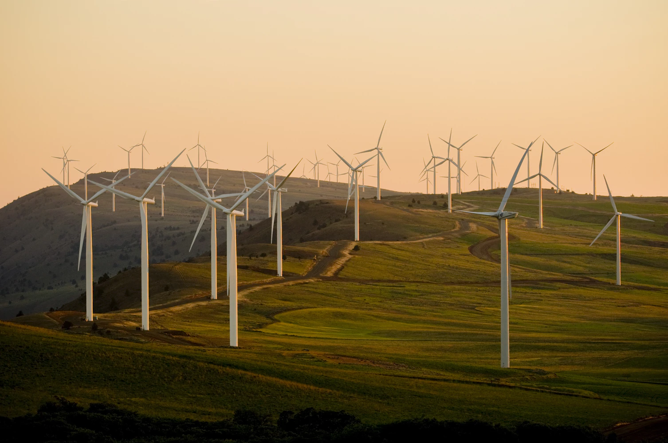
Wind power
The most cleanest way to get a power from environment

Slide 4
Solar Power Panels
How solar panels impact on the environment?
Land
Habitat
Water
Hazardous materials in manufacturing

Slide 5
Geothermal energy

Slide 6
Biomass for electricity
What deference has biomass power plants from fossil fuel power plants?
Why biomass pans can be sustainable produced, while fossil fuels are not-renewable?

Slide 7
Hydroelectric power
Why Hydroelectric power plans impact on live-cycle Global Warming Emissions?

Slide 8
Hydrokinetic energy

Slide 9

LEED
Leadership in Energy and Environmental Design

Slide 10
Thank you

